Slide 1
Tren Photography Website Analysis
“Capturing Timeless Moments Through Artistry"

Slide 2
Introduction
Overview: Tren Photography excels in capturing memorable moments, focusing on weddings and events.
Design Elements: Visually stunning website with captivating video background, elegant navigation, and dynamic slideshows.
Code Basis: Utilizes HTML and CSS for a well structured and responsive design.

Slide 3
Objectives
Core Objectives: Capture memorable moments, provide exceptional services, and showcase authentic emotions.
Timeless Memories: Commitment to creating lasting memories for clients through innovative and personalized approaches.

Slide 4
Requirements
Key Features: Engaging visual design, intuitive navigation, dynamic image slideshow, contact form, and responsive design.
SEO Optimization: Implementation for improved search engine visibility.
Easy Content Updates: Content management system (CMS) for hassle free updates.

Slide 5
Methodology
Systematic Approach: Steps include requirement gathering, design planning, HTML/CSS implementation, iterative development, testing, and deployment.
Iterative Development: Allows for continuous refinement based on feedback.
Quality Assurance: Rigorous testing ensures optimal performance and usability.

Slide 6
Coding Templates
Showcase snippets from Tren.html and Style.css.
Key Sections: Header, home, about, gallery, contact, and footer.
Script Features: Image slideshow and mute button functionality.

Slide 7
Results
Enhanced Online Presence: Significant improvement in visibility and reach.
Increased Engagement: User friendly design leads to higher client inquiries and bookings.
Positive Feedback: Clients praise the website's design, navigation, and photography services.

Slide 8
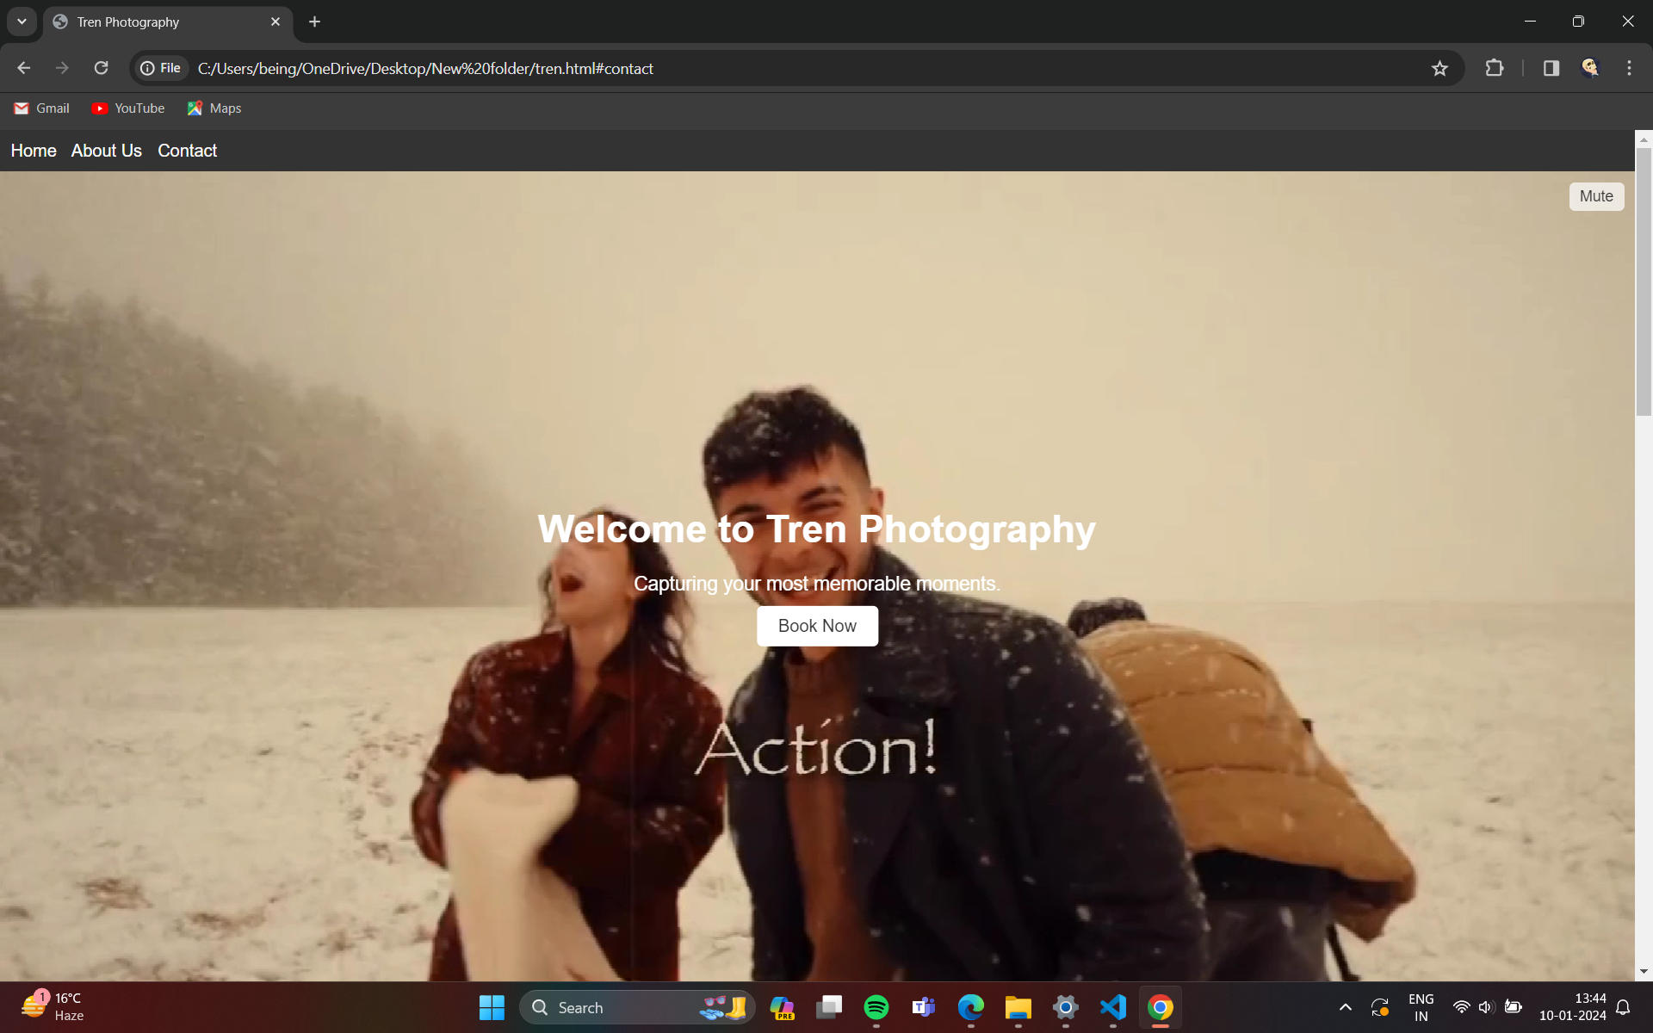
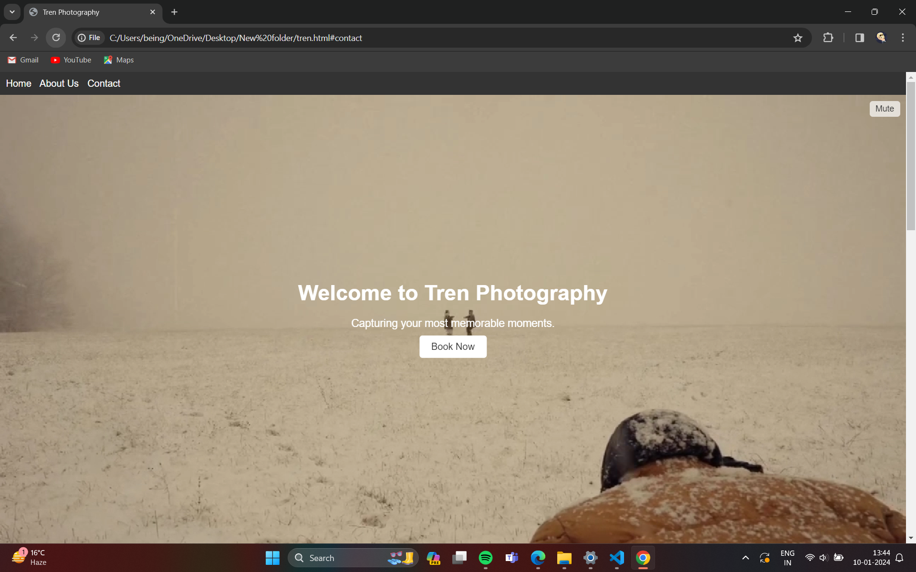
Images from the Website

Slide 9
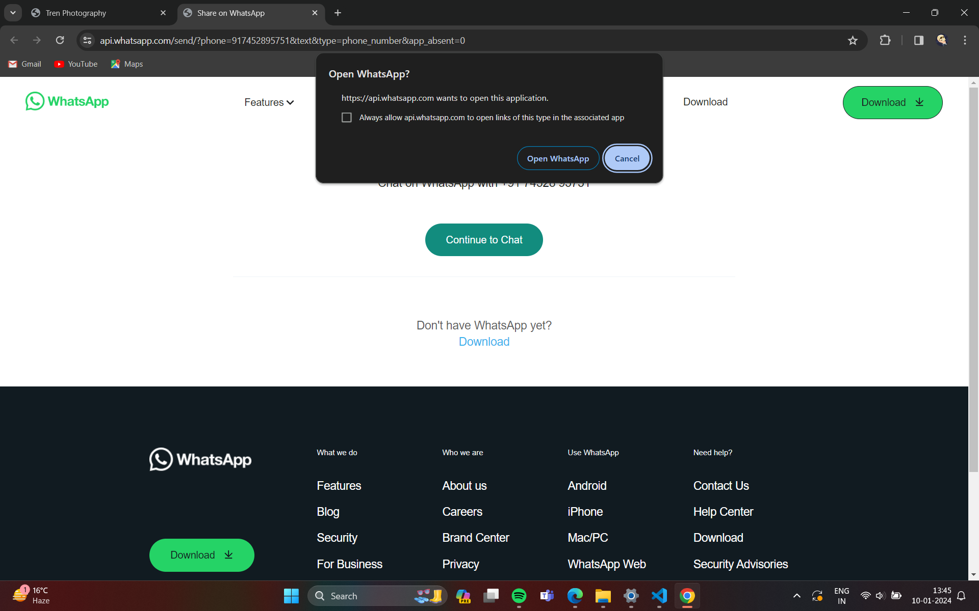
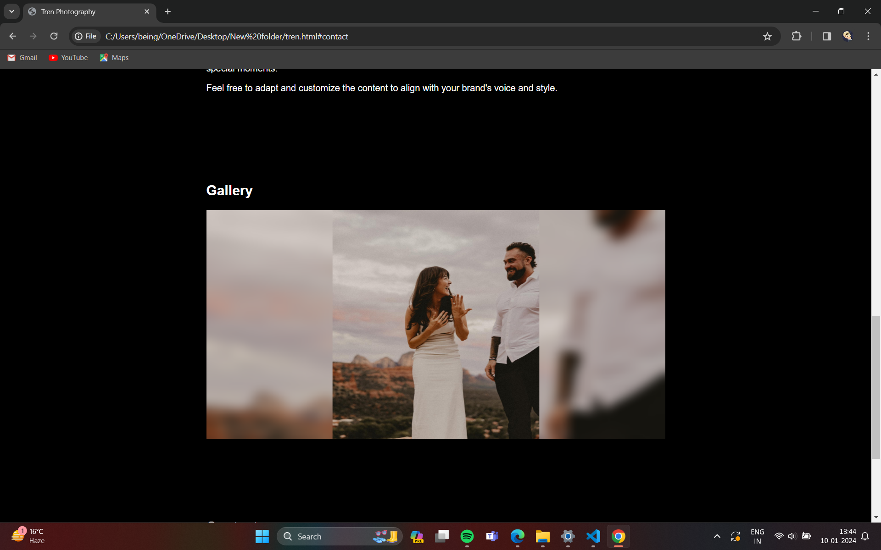
Images from website

Slide 10
Conclusion
Overall Success: Website achieves objectives of professionalism, engagement, brand identity, and positive feedback.
Positive Outcomes: Enhanced online presence, improved communication, and increased brand recognition.
Visual Element: Represent success through a visual collage or design element.

Slide 11
THANKYOU

